Slide 1

MECHANISM OF BLUETOOTH AND NOISE CANCELLATION
Prepared by a tyro
- Soma Sundaram M

Slide 2
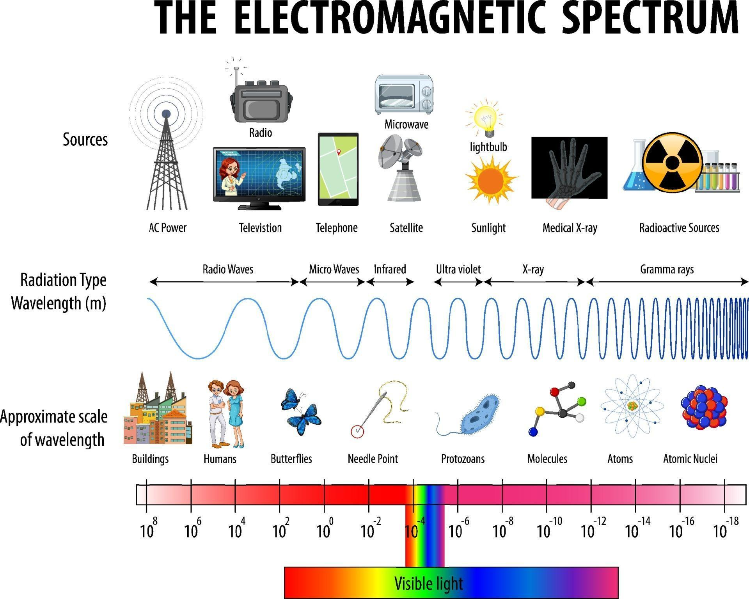
HOW DOES BLUETOOTH WORK?
To start with, Your brain interrupts various range of colors in traffic lights by the help of electromagnetic spectrum.
Green light-540nm,Yellow light-570nm, Red light-700nm.
These are present in the visible light region.

Slide 3
Frequency and wavelength
So, from the electromagnetic spectrum only the Bluetooth and mobile uses MICROWAVES and RADIO waves for sending data.
Wavelength range: Generally from 120.7nm to 124.9nm.
Its transmits data in the form of 1’s and 0’s.
Wavelength of 1- 121nm(2.4835GHZ).
Wavelength of 0- 124nm(2.4GHZ).
Millions of bits are transmitted per second.
These electromagnetic waves travel in a spherical region in both mobile and Bluetooth rather than single sinusoidal waveform.

Slide 4
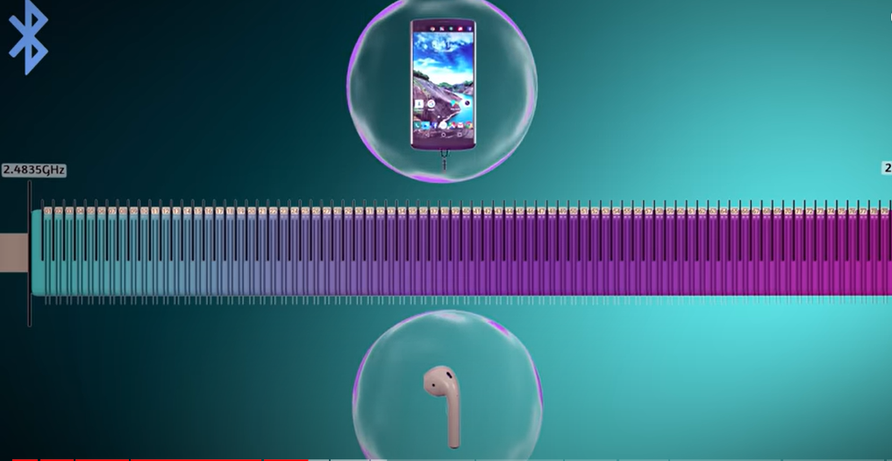
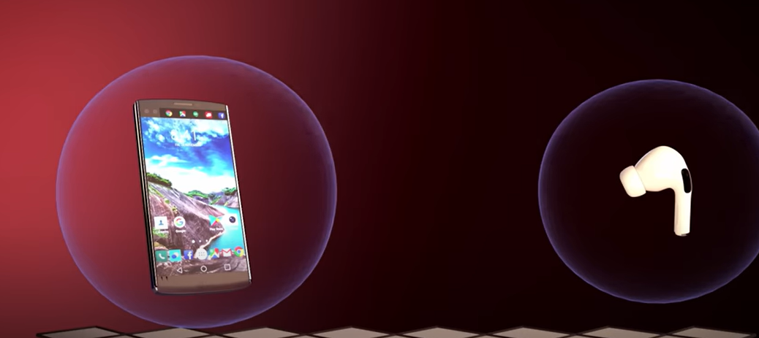
Radiation pattern
Why in spherical waveform?
It is because when it travels in the single sinusoidal waves it cannot send signals when either of them are moved away from the axis of the waves.
How does Bluetooth match with the mobile?
Basically 80 channels are created in the frequency range of 2.4ghz(0) to 2.4835ghz(1).
Out of these 80 channels 79 channels are used for pairing and the last 1 channel is used as guard band to avoid interference of other devices.
Each channel is of 1MHZ width.

Slide 5
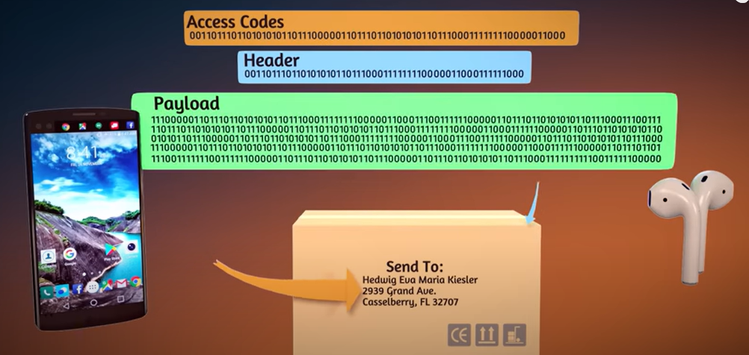
But what if they have same wavelength(lambda)?
There is a solution, which gives us 3 important parts of a PACKET.
The whole information is divided into small packets(blocks) which contains 3 major data’s:
->access code: This contain 72 bits of information which contains the unique address that helps to pair with the right devices.
->header: This part contains 54 bits of information that holds the overview details of the content(music, voice, etc.)
->body(payload): This varies from 136 bits to 8168 bits which holds the major content or information that has to be transmitted to the receiver
.(136 bits => used for pausing, playing, volume changing)
(8168 bits => used for transmitting high quality audios).

Slide 6
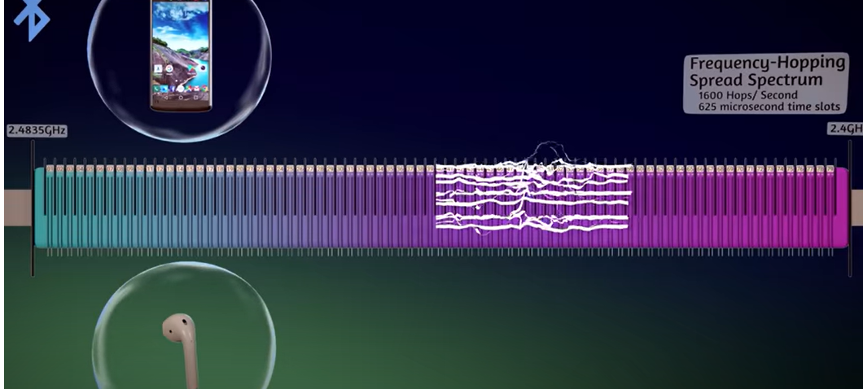
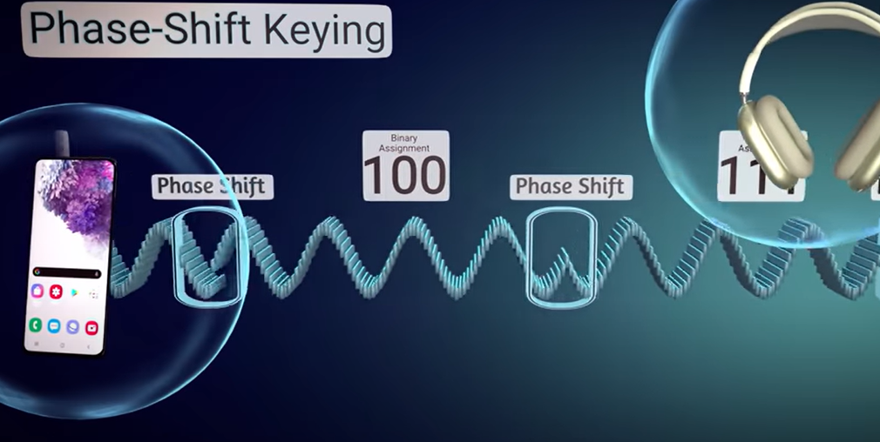
Frequency hopping spectrum
Frequency hopping spectrum is a mechanism in which the frequency hops 1600 times per second within the 79 channels.
Why? Because they cannot stick to one channel for a long time.
If any noise occurs the data will be resent to the respective channel and it will hop to other channel once it is cleared.
The whole function of Bluetooth works under the phase shift keying(PSK).
For every phase change of the wave points, it contains different data’s that are being transmitted.

Slide 7
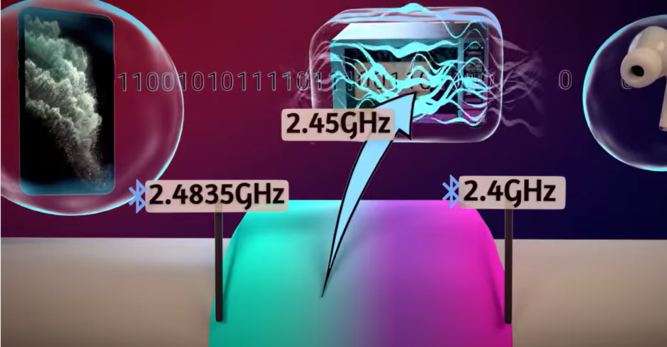
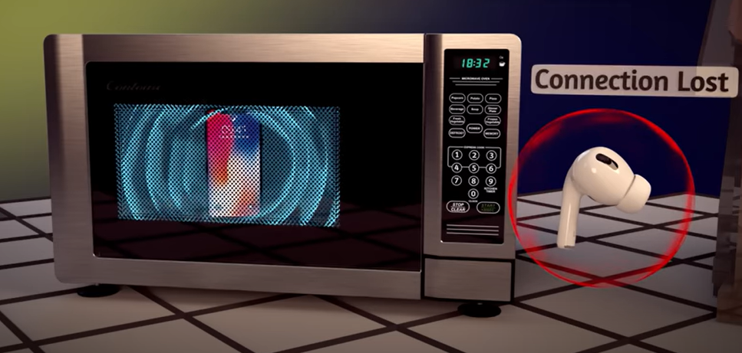
Microwave oven and Bluetooth
Even microwave oven operates at the same frequency range but it is harmful but Bluetooth is not. WHY?
Because it depends upon the way its designed internally. microwave oven is designed in such a way that it produces heat using electricity to cook the food. But Bluetooth does not generate heat using current. It transmits the data from transmitter to receiver(similar to the case of phone flash light and flood lights in stadiums).
Power of Bluetooth->0.5W an power of microwave oven -> 1000w.
But microwave oven can easily interfere while pairing Bluetooth and mobile phones.
Both have the same frequency range of 2.4GHZ.
Similarly WIFI can also interfere the pairing and the also have 14 channels for pairing to devices.

Slide 8
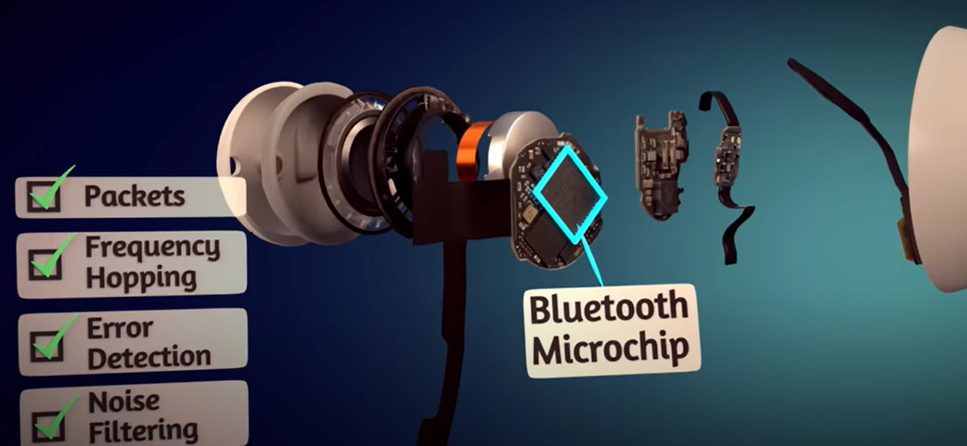
How Bluetooth is so error free?
Phase shift keying
Error correction bits
Frequency hopping
Packets of data
Noise cancellation
These are all designed inside the microchip of the Bluetooth.
Frequency modulation using carrier wave is also processed.

Slide 9
ENGINEERING INSIDE WIRLESS EARBUDS
There are 9 major components inside almost all wireless earbuds. For example we will consider apple airpods2.
9 major components are:
->Bluetooth
->audio codec
->accelerometer
->PCB
->SoC
->Lithium Ion battery
->noise cancellation
->speaker
->MEMS microphone

Slide 10
PLACEMENT OF 9 COMPONENTS:
The outer part of the buds is the plastic and behind the plastic material there is a rubber protective shell.
The rubber shell is attached to the optical sensor(detects the wavelength and frequency of the audio and convert them into electrical signal).
SPEAKER:
Behind the rubber shell comes the major component SPEAKER. It has 4 layers to transfer audio from buds to human ears.
The 4 layers are: Diaphragm, spider, voice coil, magnet.
Diaphragm converts the electrical signal to sound waves. It vibrates due to electricity.
spider detects the low frequency response and mechanical power handling.
Connected to diaphragm and it maintains the constant magnetic field which vibrates the diaphragm.
Magnet creates the magnetic field which makes the coil to move back and forth w.r.t vibrations.
Then comes the 3 PCBS(printed circuit boards).

Slide 11
PCB’s:
The 3 printed circuit boards are folded together and they are connected by flexible wires.
TOP BOARD: The top PCB board contains the Soc, accelerometers and microchip. Present at backside of the speaker.
Microchip handles the Bluetooth connectivity using the 79 channels and frequency hopping.
Accelerometers are the sensors which detect the acceleration of the signals and transfer them to 2nd PCB board.
SoC is a microcontroller or an embedded system which performs timing and storage operations and they ae mostly flash memory.
2nd BOARD: The 2nd PCB is important as it contains the Audio Codec for encoding and decoding of data.
It is a low power stereo audio processing chip.
3rd BOARD: the 3rd PCB is connected between the battery of the buds and 2nd PCB board.

Slide 12
How does buds get charged?
At the end of the battery, there is a small opening in which MEMS microphone is soldered and it has two points made of conducting material in it.
MEMS is also embedded in a small circuit board like PCB.
There is an antenna adjacent to the battery which is responsible for receiving the power supply.
MEMS microphone are application specific(ASIC). They are also known as silicon microphones. It extracts the audio pressure from the surroundings and convert them to electrical signal.
It enhances the signal to noise ratio.
They can be either ADC or DAC. But mostly in buds they have Digital MEMS microphone to increase noise immunity and less complex circuits.
They are literally a sensor for detecting the incoming signals and pressure created by the sound waves.
A small microphone is also connected at the back of the buds for noise reduction.

Slide 13
Processing your music/podcast
So, first and foremost when you play the music or audio in your mobile, it gets stored In the flash memory of your mobile. Then the music is decompressed and sent to the SoC/DRAM of the device.
The decompressed data are the digital values of your audio. These digital values are converted to packets which has access codes, header, payload.
These packets are converted to electromagnetic waves or photons and transferred to your buds.
When the device is paired, the digital values are received by the antenna and sent to 1st PCB board where the data’s are dissembled and decompressed and sent to audio codec.
Audio codec converts the digital values to electrical or analog form using the graph.
These digital values are placed in such a way that the spacing between the 2 values in 23us.
Audio codec – codec stand for coding and decoding.

Slide 14
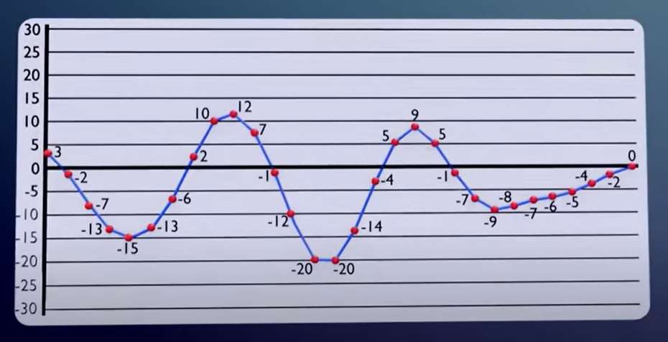
Audio codec graph
These are the digital signal values of your music. These signals are converted to the graph form as shown.
The spacing between the 2 values must be 23us.
->Why 23 microseconds?
When these signals are placed more closer than 23 microseconds, the frequency increases and millions of waves will be produced which is difficult for humans to hear(ultrasonic range in electromagnetic spectrum).
Now the frequency values will be 44.1KHZ which human can hear.

Slide 15
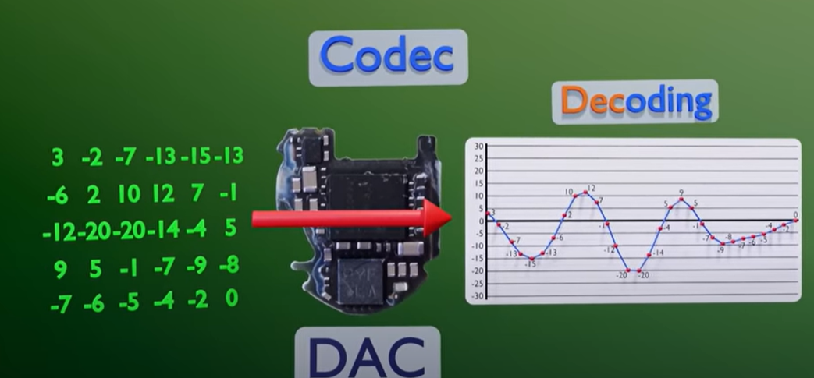
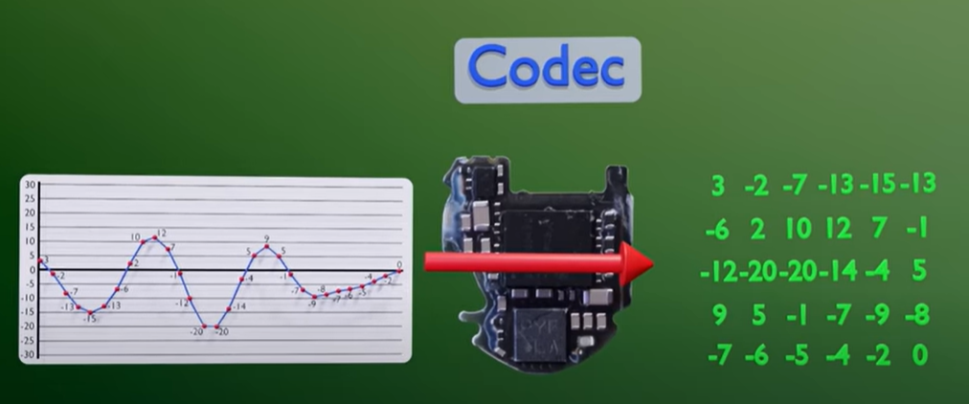
Type of conversion
The audio codec can convert digital to analog as well as analog to digital.
In case of earbuds it converts music(decompressed as digital) to analog(graph) and these analog signals are transferred to voice coil of the buds and creates pressure which moves the voice coil back and forth and finally the sound waves enters the human ears and our brain interrupts the music.

Slide 16
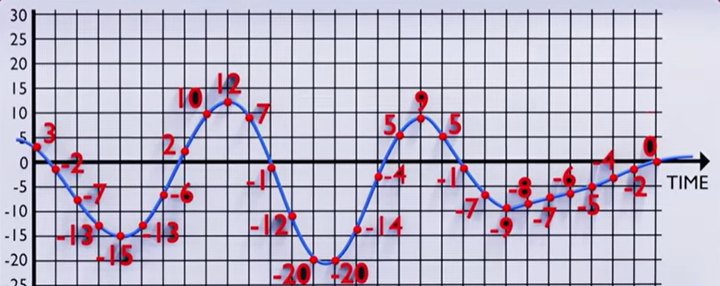
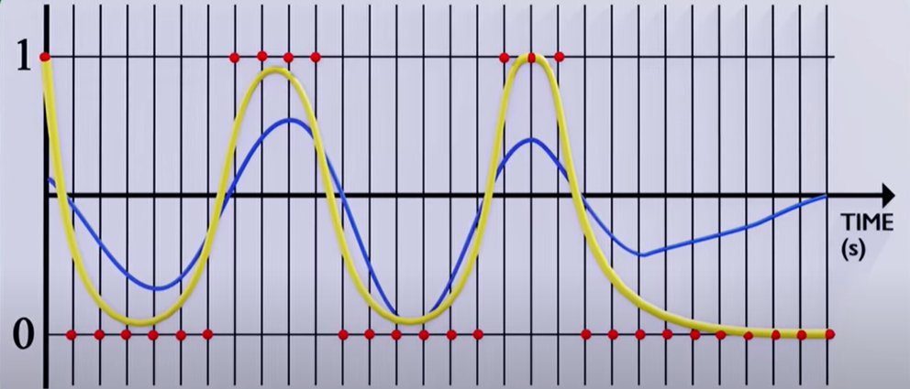
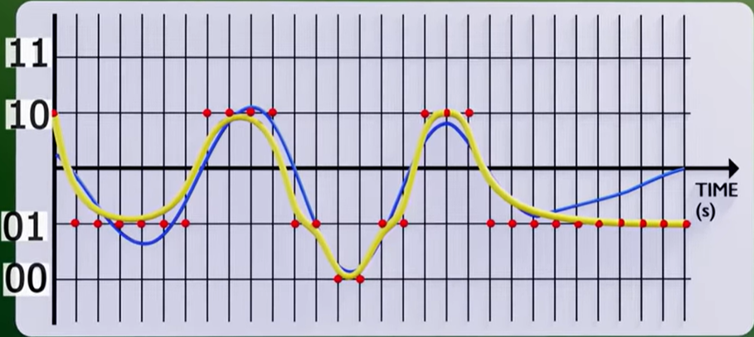
How is the graph formed?
Instead of performing complex math and equations, the analog signal is just placed in a graph of values. X axis -> 23us
Y axis -> it depends the audio quality. When the input is 2 bits ( 1,0) the graph would not match to the original analog signal.
So 16 bits (2^16=65536) values must be there in Y axis. For high quality of audio it goes up to 24 and 32 bits.
The signal values are 1’s and 0’s (access codes, headers and payload). When these are plotted in the graph, it forms a wave and these waves are sent to audio codec for making the wave propagation smoother and better.

Slide 17
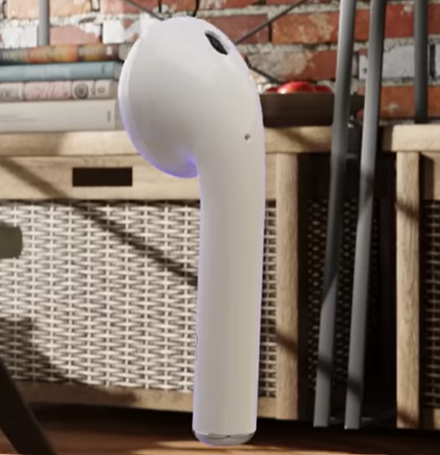
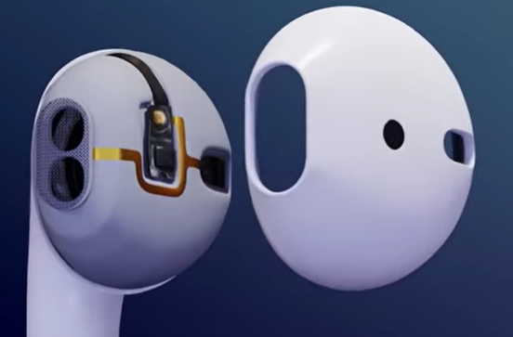
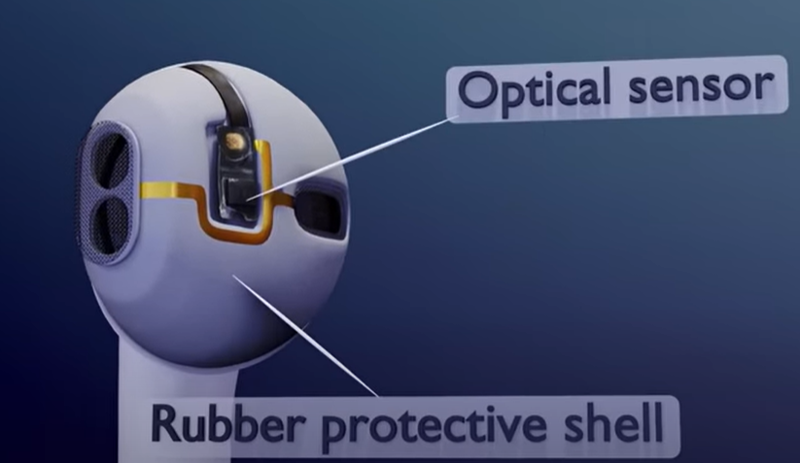
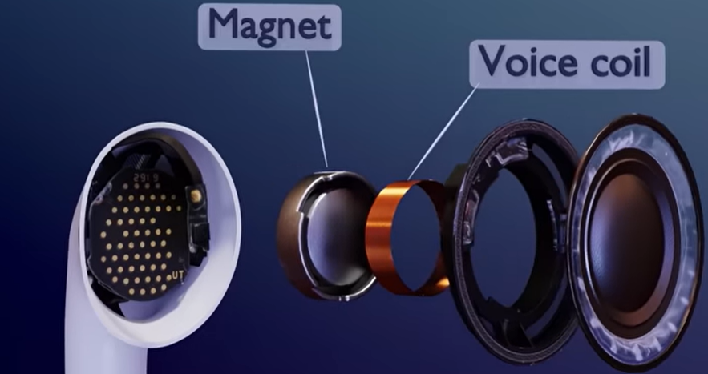
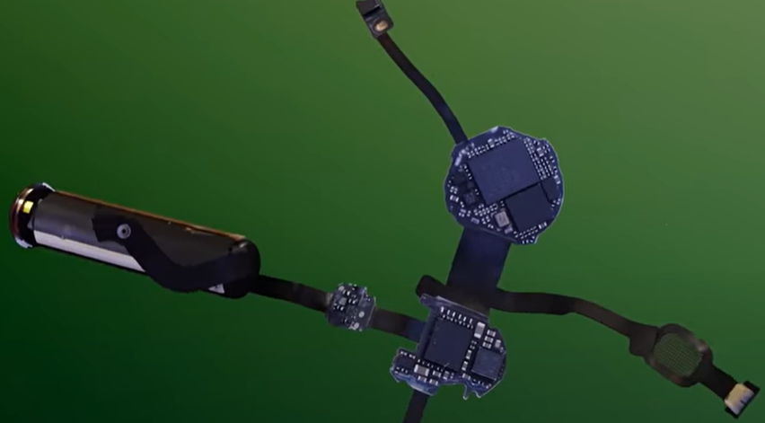
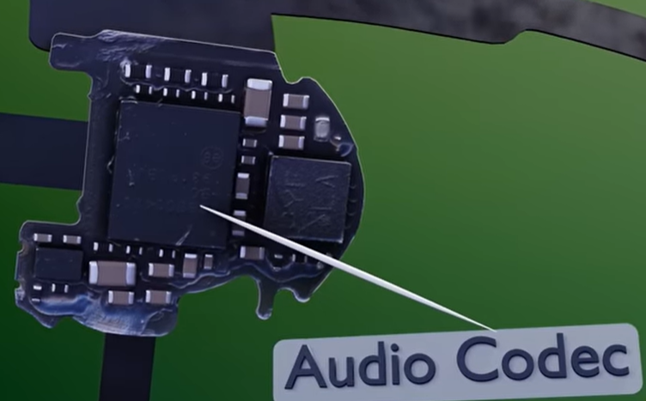
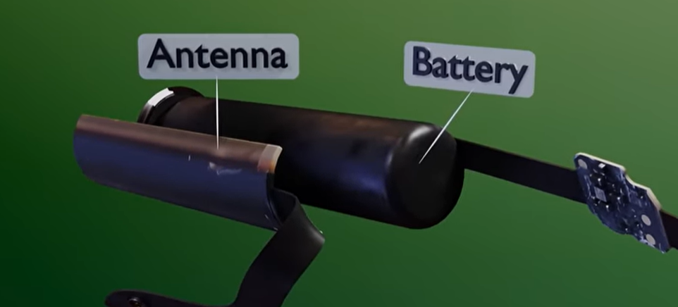
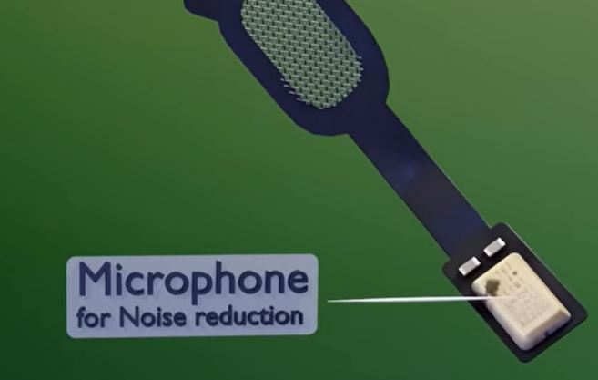

INSIDE APPLE AIRPODS 2

Slide 18
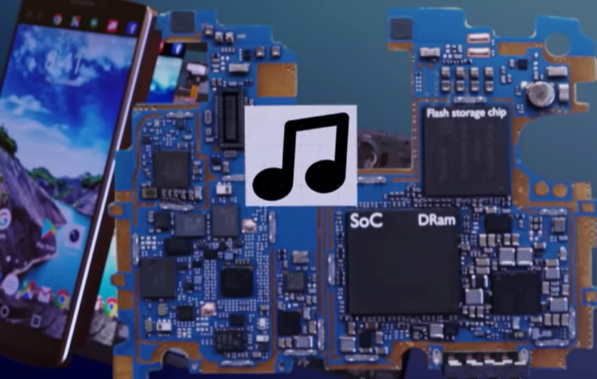
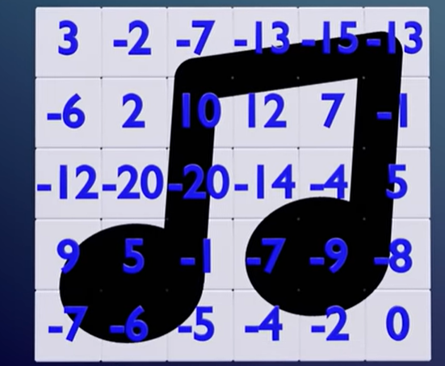
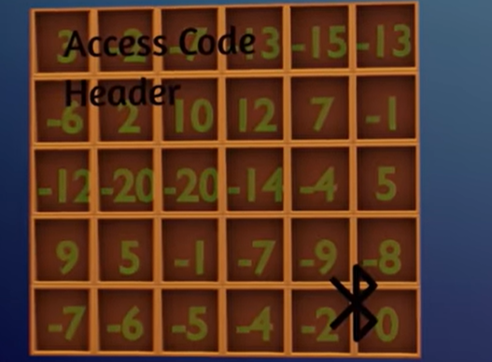
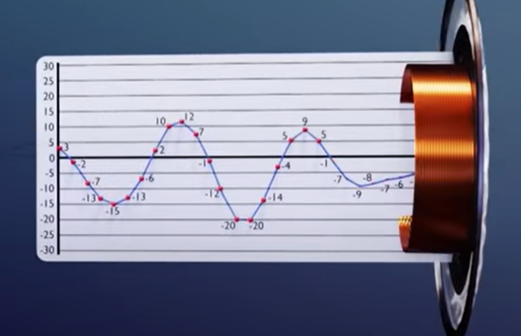
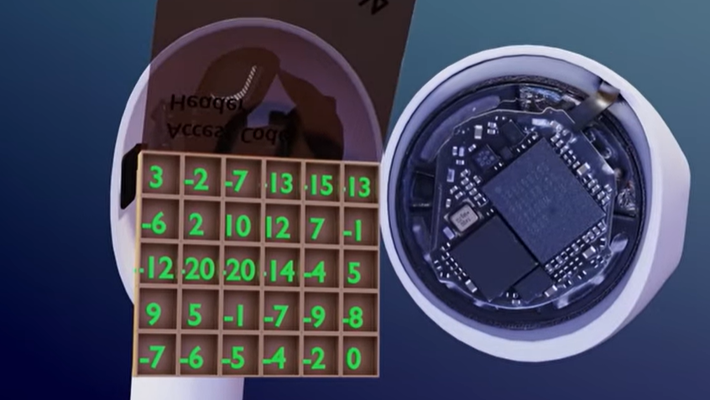
PICTURIZING THE PROCESS

Slide 19
HOW DOES ACTIVE NOISE CANCELLATION WORK?
So, why only apple air pods have better noise cancellation compared to other Bluetooth devices?
The answer is PROCESSORS.
Active noise cancellation follows the principle of equal and opposite reaction.
There are lots of external noise from trucks, cars, birds, humans, etc. and these noise has to be cancelled by the Bluetooth devices to give a noise less music.
BUT HOW?

Slide 20
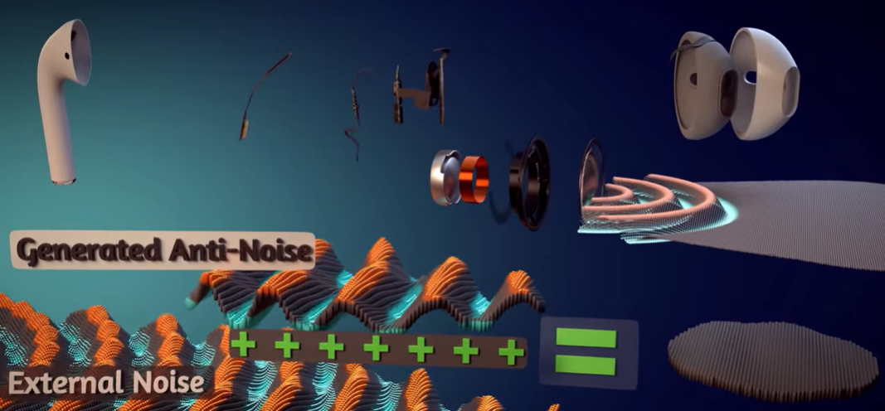
WORKING BEHIND THE NOISE CANCELLATION
The major component which does this is the microphone which is connected along with the 3 PCB’s of the Bluetooth.
But there are 2 Microphones inside the Bluetooth. One to detect the external noise from the environment which is at the back of the device and the other is in the internal of the device to measure the percentage of error and transmit the music.
After calculating the amount of noise, it generates a ANTI-NOISE which is combined with the external noise to nullify the final output.

Slide 21
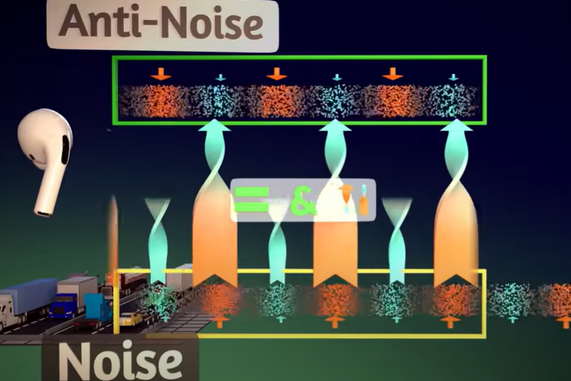
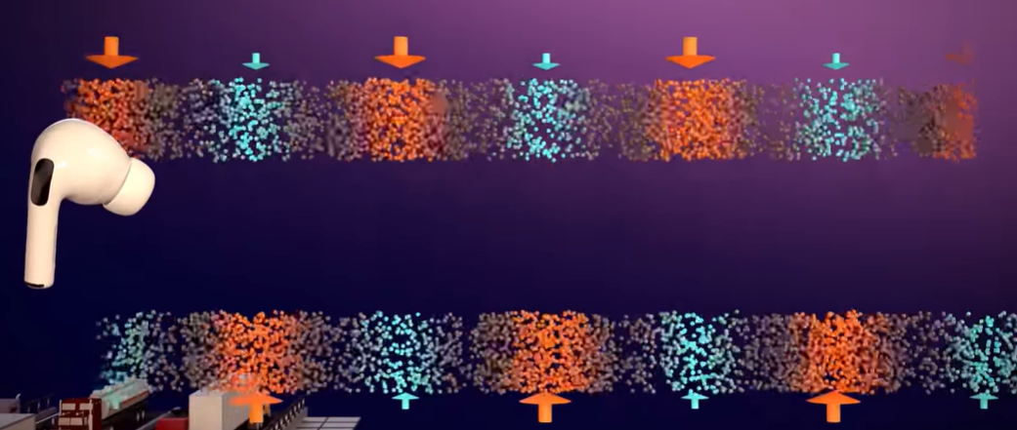
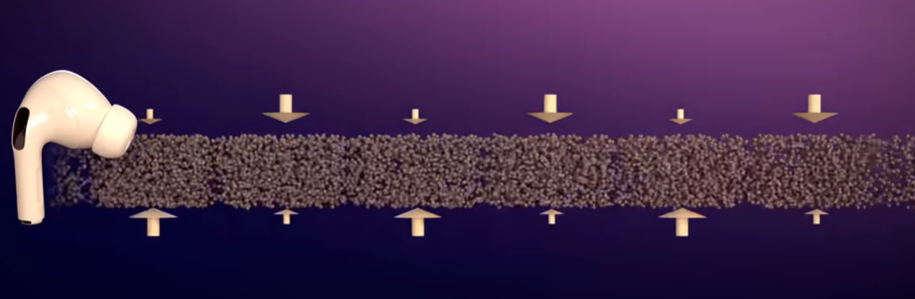
What are the external noises?
External noises are simply the combination of high pressure and low pressure waves(compression and rarefaction).
The generated anti-noise would create a similar wave which has equal and opposite waves to get combined with the external noise to cancel out each other.
This process is called destructive interface.

Slide 22
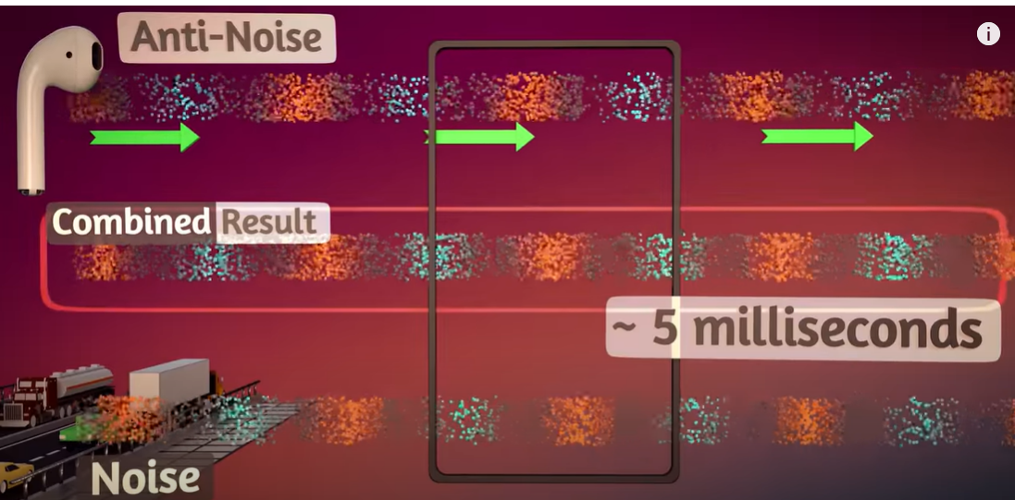
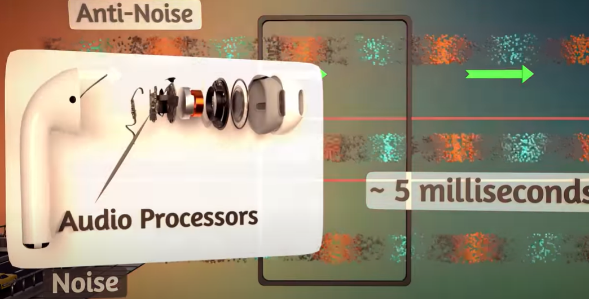
The problem!
But the major problem faced by this process is, it is difficult to match the 2 waves at the correct time accurately.
There are 100’s of waves per second and if the any one zone is out of the process, the active noise cancellation will not work properly.
To solve this, Bluetooth are designed in such a way that they detect the low frequency signals which is easier to match with anti-noise as it contains less number of waves per second.
And another solution is that it uses high quality digital processors to measure and calculate the anti-sound wave.

Slide 23
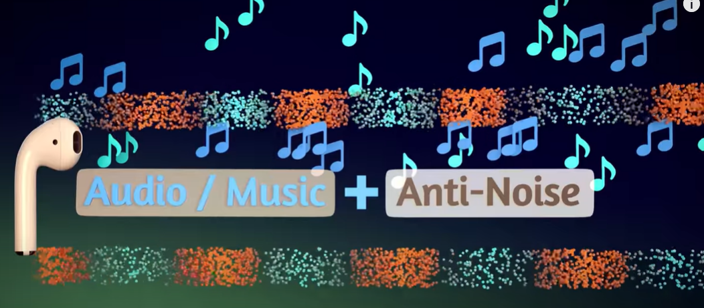
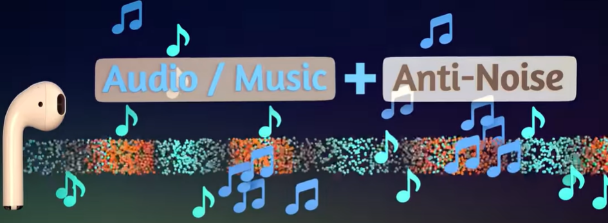
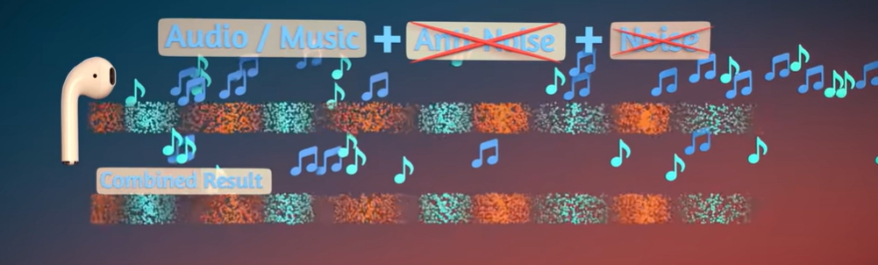
summary
Firstly the anti-noise produced by the microphone is combined with the music/audio.
The combined wave form is again matched with the external noise, and equation looks like
Music/audio + anti-noise + noise = noiseless music/audio.
Thus the apple air pods uses advanced microprocessors to detect and nullify the external noise compared to other brands and hence successful in world market.

